Slide 1
Learning intentions and success criteria
I am learning…
I can…
About audio transfer
About different methods of transferring audio
Describe how audio can be transferred from one device to another
Identify the differences between audio transfer methods

Slide 2

Audio Transfer
NPA Digital Media (Level 5)

Slide 3
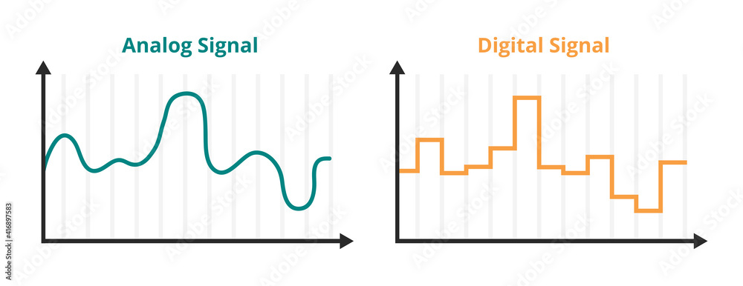
Recap: Digital Sound
The measurements of the sound wave are converted to binary values:
Like a staircase – you can step up or step down
An audio file is just a list of these steps – to reproduce the wave approximately

Slide 4

Audio Transfer
Once an audio file (MP3, WAV, etc.) is created, it can be transferred from one device to another.
There are two main ways to do this:
Using cables to connect the two devices together
Using a wireless method

Slide 5
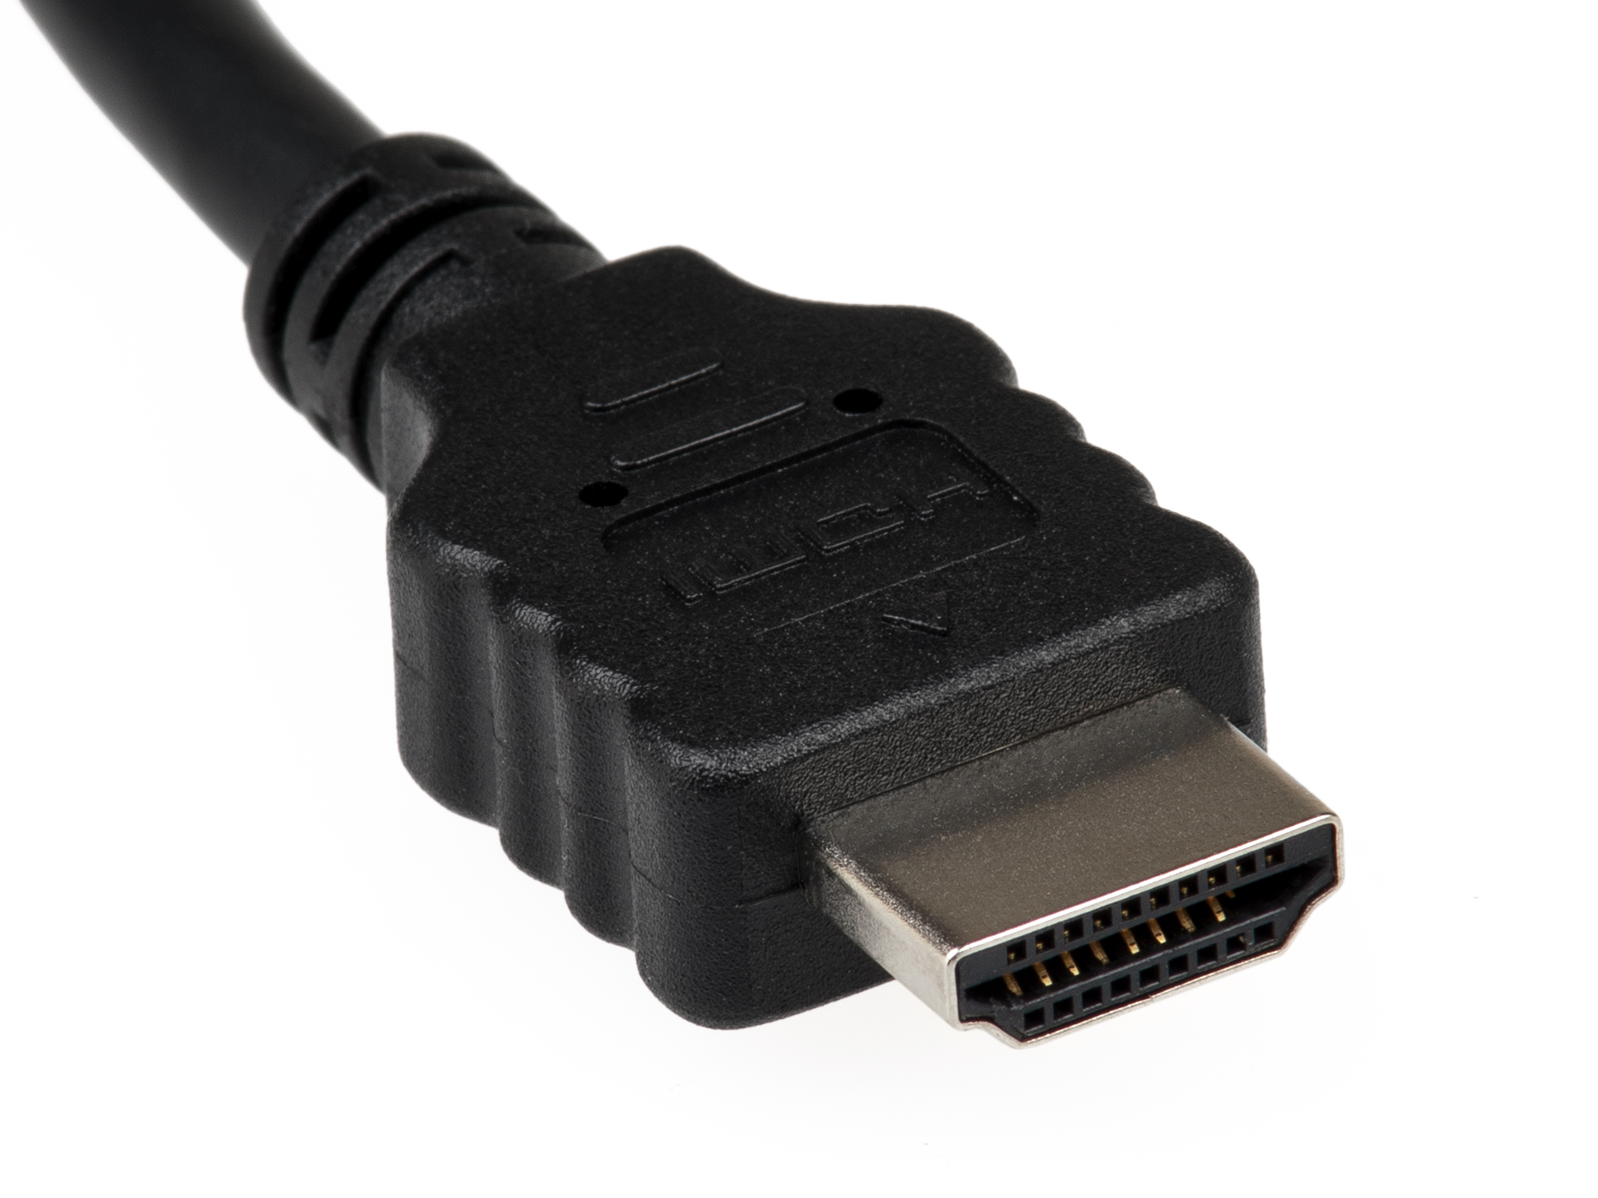
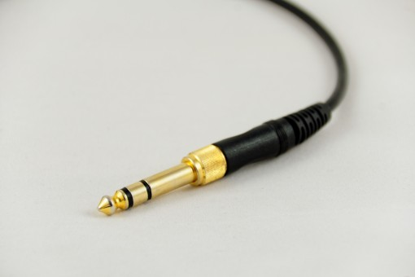
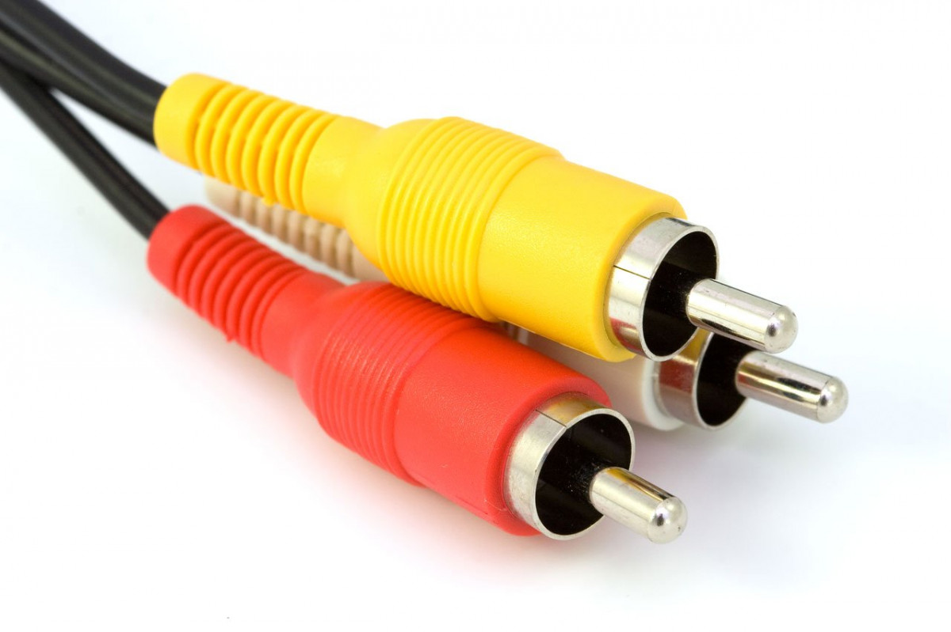
Audio Cables
There are many cables which can carry audio data between once device and another:
High-Definition Multimedia Interface (HDMI)
Display Port (DP)
Digital Visual Interface (DVI)
Auxiliary cable (3.5mm or ¼ inch)
USB Type-C
Coaxial cable
Digital optical cable
Some of these are just for carrying audio data, while some of them carry both video and audio at the same time.

Slide 6

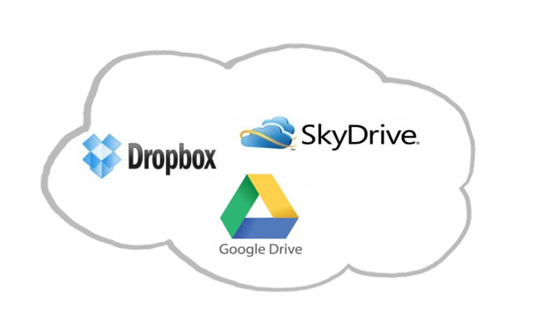

Wireless Methods
In recent times, it can be more convenient to transfer data wirelessly, using a few different methods:
Bluetooth:
Transfer audio across a short distance between 2 devices
E.g. listening to a podcast on Bluetooth headphones
Wi-Fi:
Stream audio from the Internet to your device
E.g. streaming music from Spotify or Apple Music
Cloud Storage:
Store audio files on a cloud service
e.g. using OneDrive, Dropbox or Google Drive

Slide 7
Learning intentions and success criteria
I am learning…
I can…
About audio transfer
About different methods of transferring audio
Describe how audio can be transferred from one device to another
Identify the differences between audio transfer methods

